Slide 1
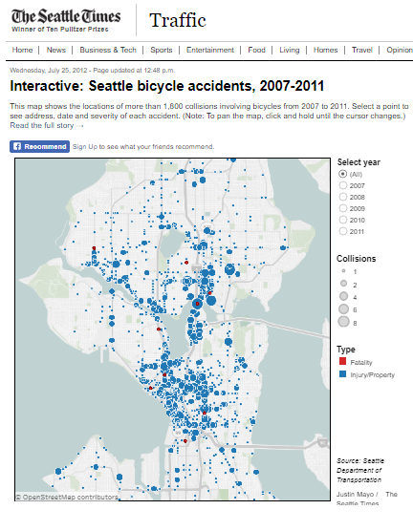

Bike Collision Analysis
Washington -Seattle
Presented by:
Greg
Tejasvi
Amanraj

Slide 2
Motivation
In 2015, 818 people lost their lives in bicycle/motor vehicle crashes, more than two people every day of the year in the U.S
1
Bicyclist deaths in 2006: 772
2
Bicyclist deaths in 2015: 818 (NHTSA Traffic Safety Facts)
3
Estimated bicyclist injuries in 2006: 44,000
4
Estimated bicyclist injuries in 2015: 45,000 (NHTSA Traffic Safety Facts)
5

Slide 3
Vision
Accident prone areas of the City for bike accidents
When do accidents happen?
Can we help hospitals predict number of accidents per day/weekly/monthly

Slide 4
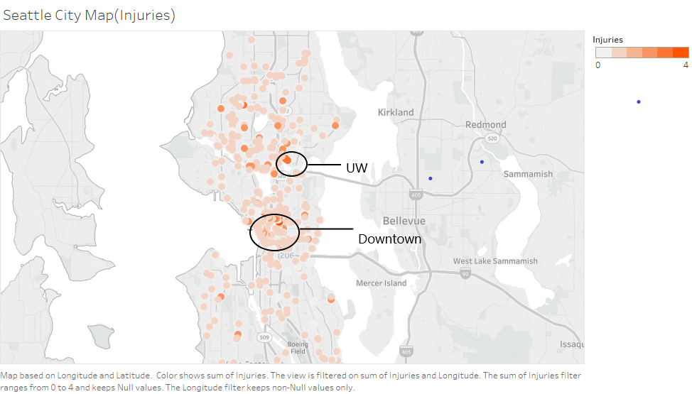
EDA(Exploratory Data Analysis)

Slide 5
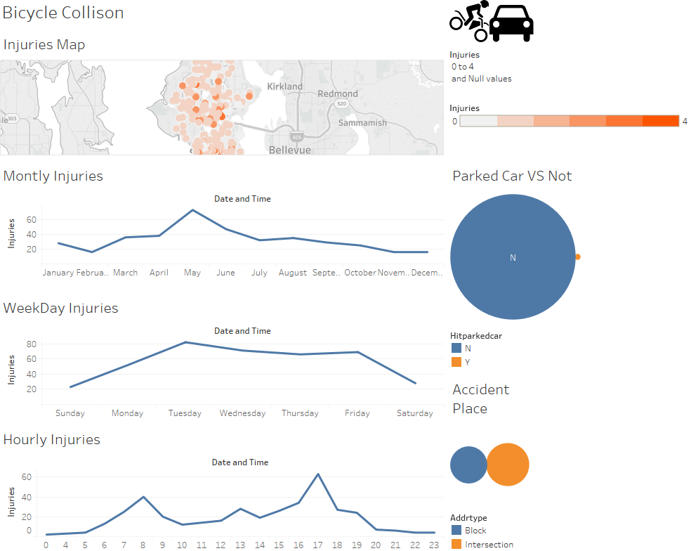

Slide 6
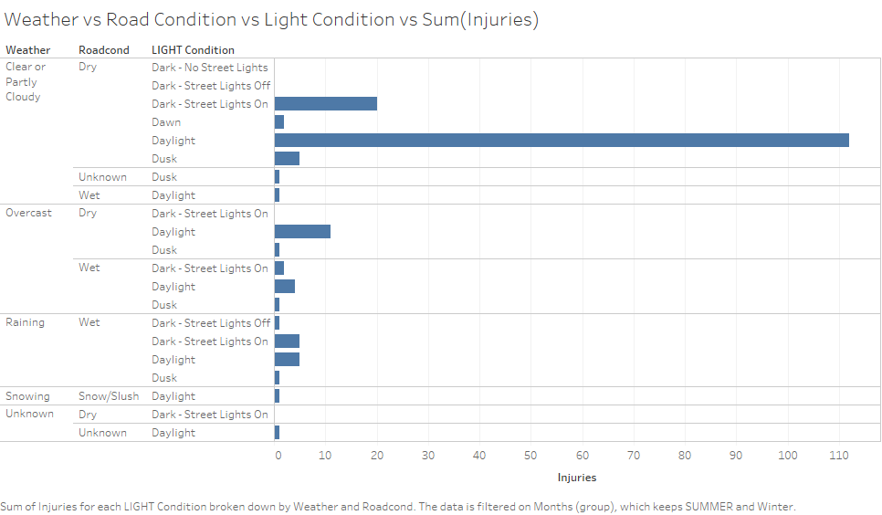

Slide 7
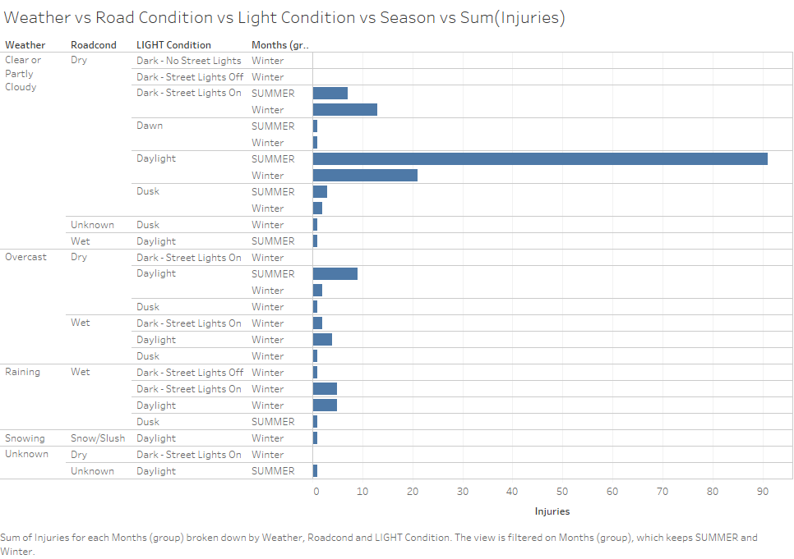

Slide 8
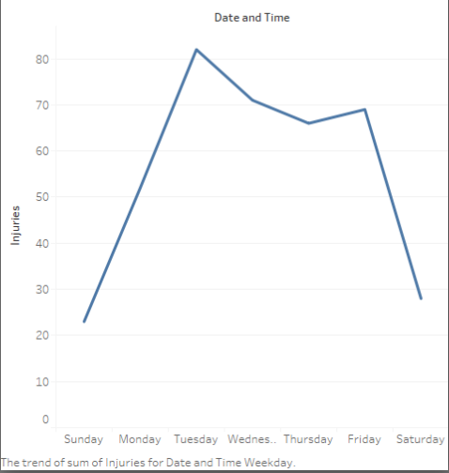
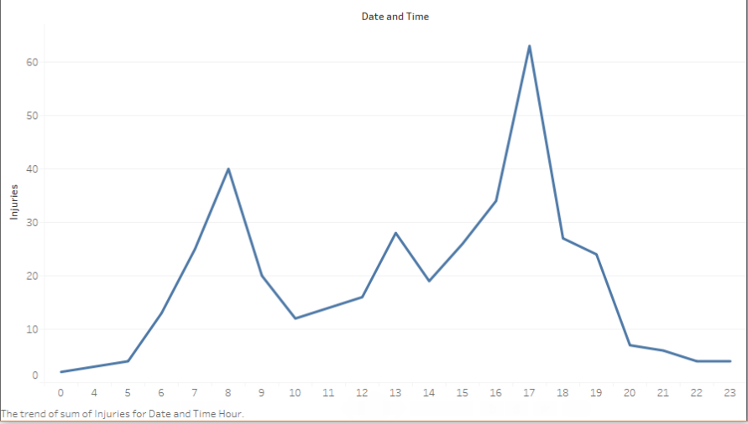
Week Day Injuries
Hourly Injuries

Slide 9
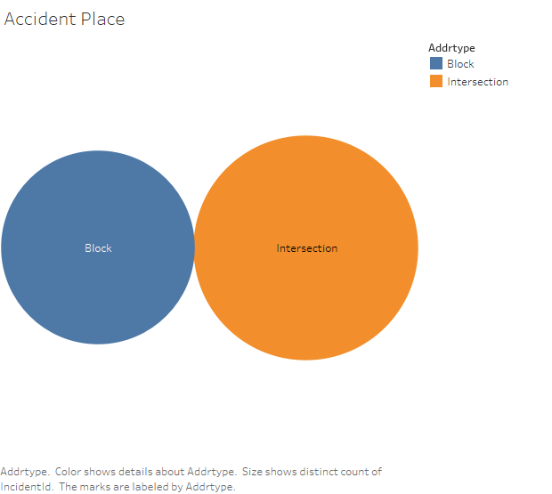
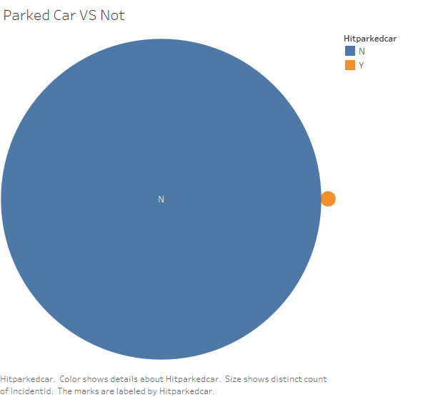

Slide 10
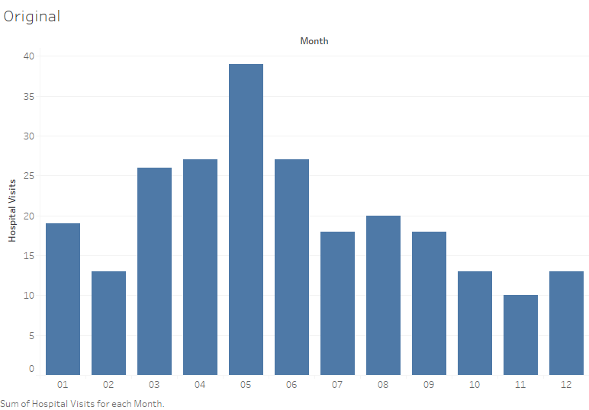
Monthly Trends

Slide 11
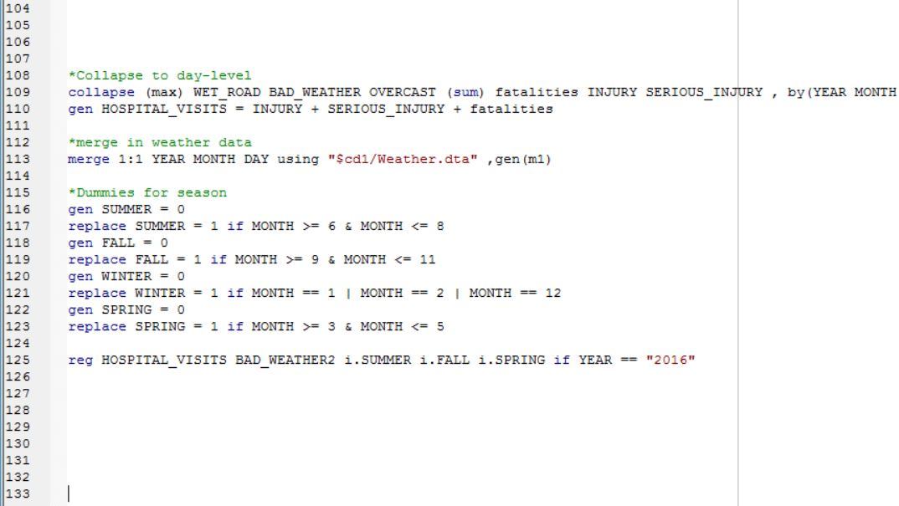
Some explanation of the operations

Slide 12
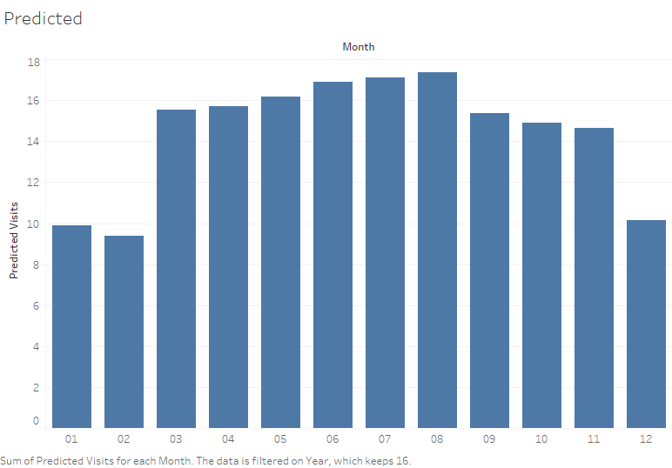
Predictive Analysis [Fall]*0.166+[Summer]*0.202+[Spring]*0.175+[Bad Weather2]*-0.055+.363

